Slide 1
Chap. 01 Elementary Continuous-Time and Discrete-Time Signals and Systems

Slide 2
SYSTEMS IN ENGINEERING
The word system refers to many different things in engineering. It can mean, in a more abstract way, theoretical objects such as a system of linear equations or a mathematical input-output model. In this book, a system is defined as a mathematical relationship between an input signal and an output signal, and a mathematical representation of this system is usually called a system model.

Slide 3
FUNCTIONS OF TIME AS SIGNALS
There are two types of signals: continuous-time signals and discrete-time signals.
Continuous-time signals are functions of a continuous variable (time). (Fig. 1.1)
Discrete-time signals are functions of a discrete variable; that is, they are defined only for integer values of the independent variable (time steps). (Fig. 1.2)

Slide 4
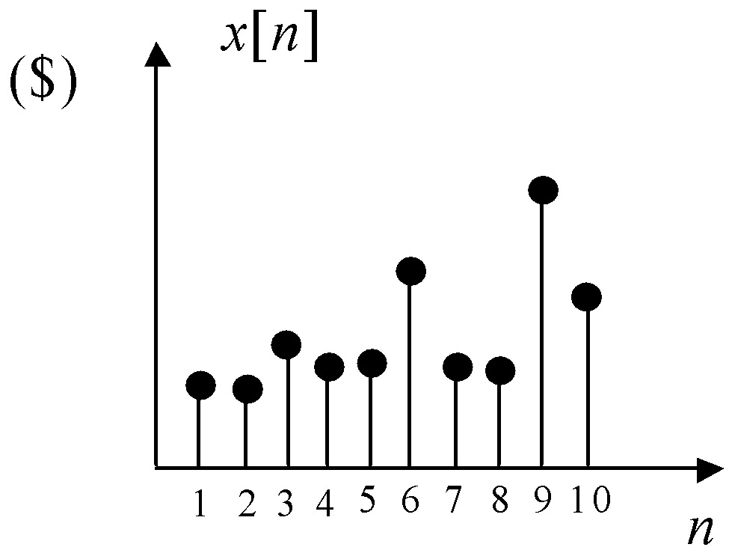
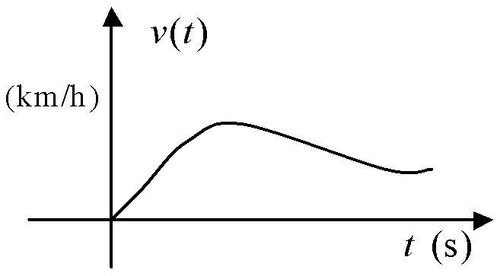
FIGURE 1.1 Continuous-time signal representing the speed of a car.
FIGURE 1.2 Discrete-time signal
representing the value of a stock.

Slide 5
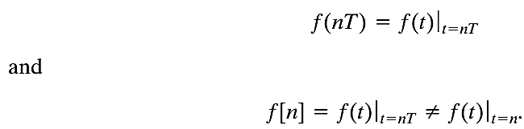
The notation f(t) indicates a continuous-time signal. The notation f(nT) indicates the value of f(t) at t = nT. The notation f[n] denotes a discrete-time signal that is defined only for n an integer. Parentheses indicate continuous time; brackets indicate discrete time. However, this notation is
not universal; it is used here in an attempt to differentiate between f(nT) and f[n].
If f[n] is obtained from f(t) by sampling every T seconds, then

Slide 6
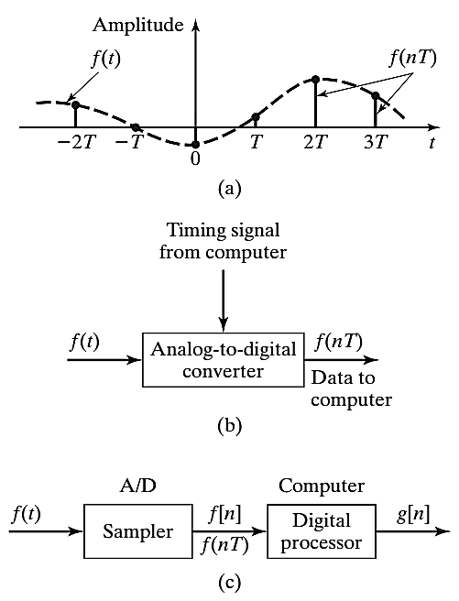

Slide 7
We will study both real and complex signals in this book.
Note that we often use the notation x(t) to designate a continuous-time signal and x[n] to designate a discrete-time signal.

Slide 8
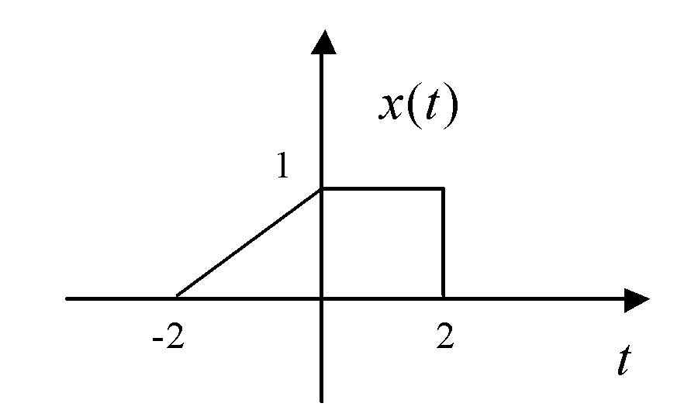
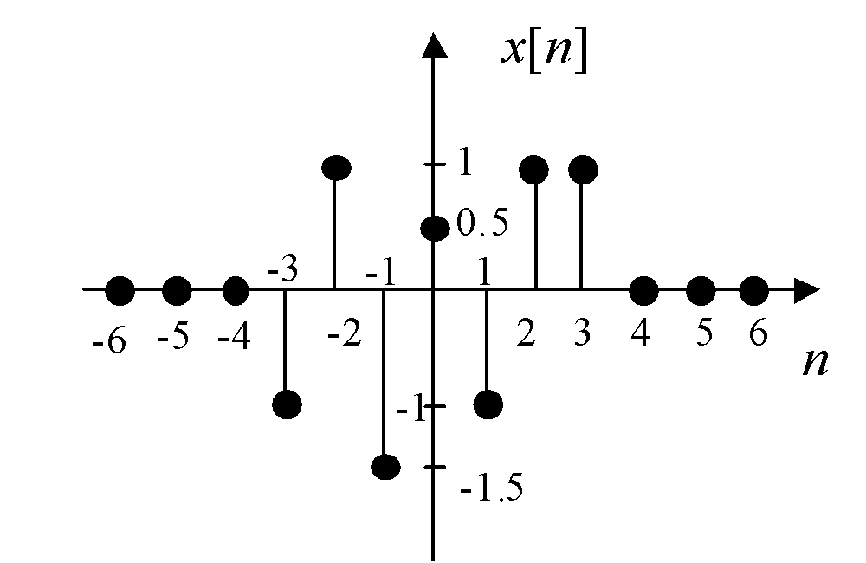
TRANSFORMATIONS OF THE TIME VARIABLE
Consider the continuous-time signal x(t) defined by its graph shown in Figure 1.4 and the discrete-time signal x[n] defined by its graph in Figure 1.5.
We will use these two signals to illustrate some useful transformations of the time variable, such as time scaling and time reversal.
FIGURE 1.4 Graph of continuous time signal x(t).
FIGURE 1.5 Graph of discrete-time signal x[n].

Slide 9
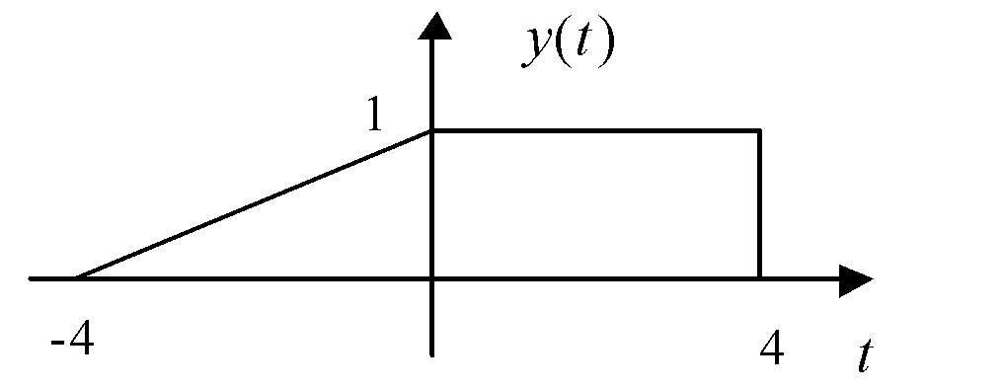
Time Scaling
Time scaling refers to the multiplication of the time variable by a real positive constant α. In the continuous-time case, we can write
y(t) = x(αt)
Case 0 < α < 1: The signal x(t) is slowed down or expanded in time.
Example 1.3: Case α = 1/2 shown in Figure 1.6.
FIGURE 1.6 Graph of expanded signal y(t) = x(0.5t).

Slide 10
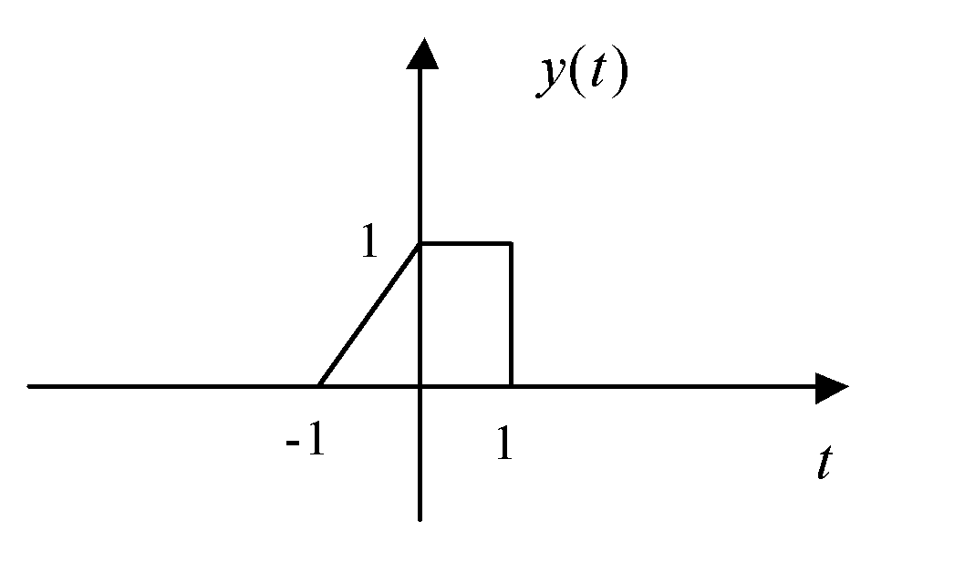
Case α > 1: The signal x(t) is sped up or compressed in time.
Example 1.4: Case α = 2 shown in Figure 1.7.
FIGURE 1.7 Graph of compressed signal y(t) = x(2t)

Slide 11
For a discrete-time signal x[n], we also have the time scaling
y[n] = x[αn]
but only the case α > 1, where α is an integer, makes sense, as x[n] is undefined for fractional values of n. In this case, called decimation or downsampling, we not only get a time compression of the signal, but the signal can also lose part of its information; that is, some of its values may disappear in the resulting signal y[n].

Slide 12
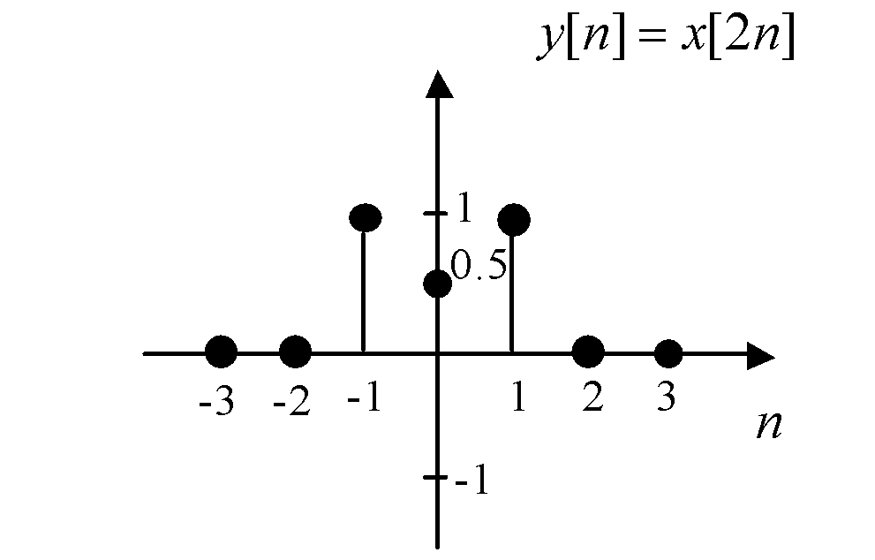
Example 1.5: Case α = 2 shown in Figure 1.8
FIGURE 1.8 Graph of compressed signal y[n] = x[2n].
In Chapter 12, upsampling, which involves inserting m – 1 zeros between consecutive samples, will be introduced as a form of time expansion of a discrete-time signal.

Slide 13
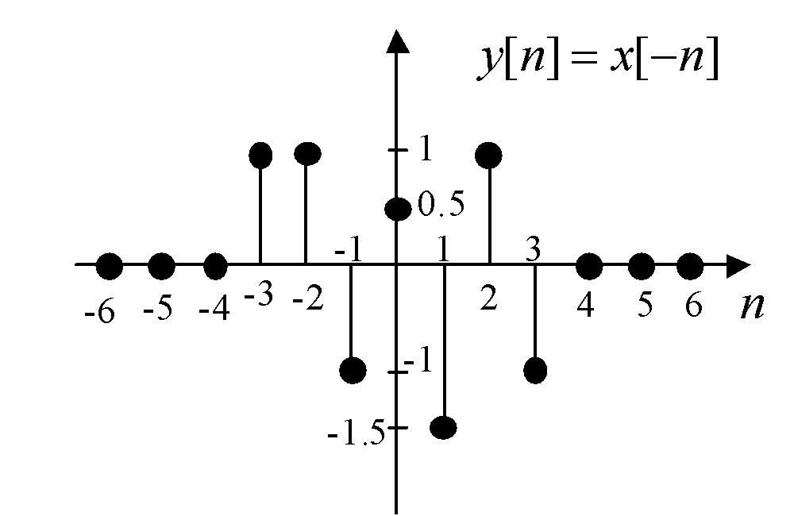
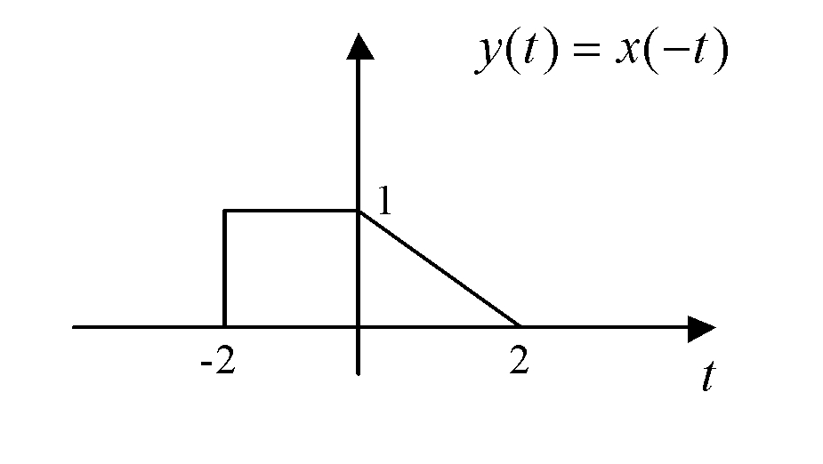
Time Reversal
A time reversal is achieved by multiplying the time variable by –1.
FIGURE 1.9 Graph of time-reversed signal y(t) = x(–t).
FIGURE 1.10 Graph of time-reversed signal y[n] = x[–n].

Slide 14
Time Shift
A time shift delays or advances the signal in time by a continuous-time interval Tϵ R :
y(t) = x(t + T)
For T positive, the signal is advanced; that is, it starts at time t = –4, which is before the time it originally started at, t = –2, as shown in Figure 1.11. For T negative, the signal is delayed, as shown in Figure 1.12.

Slide 15
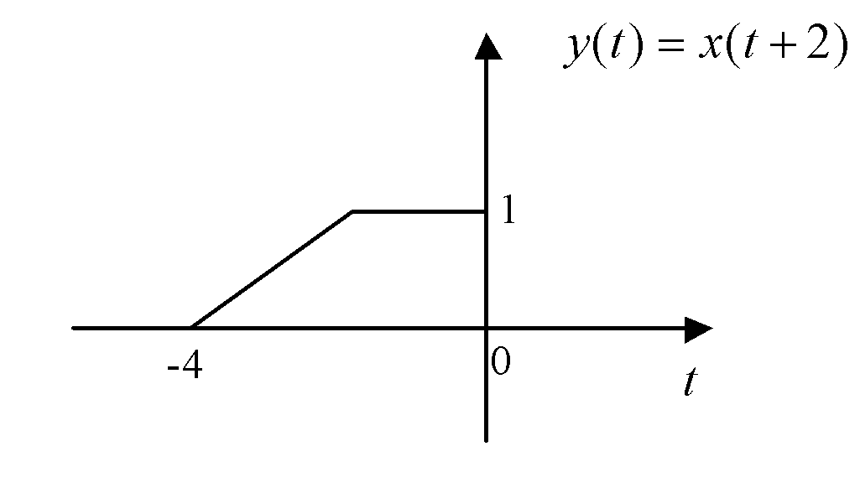
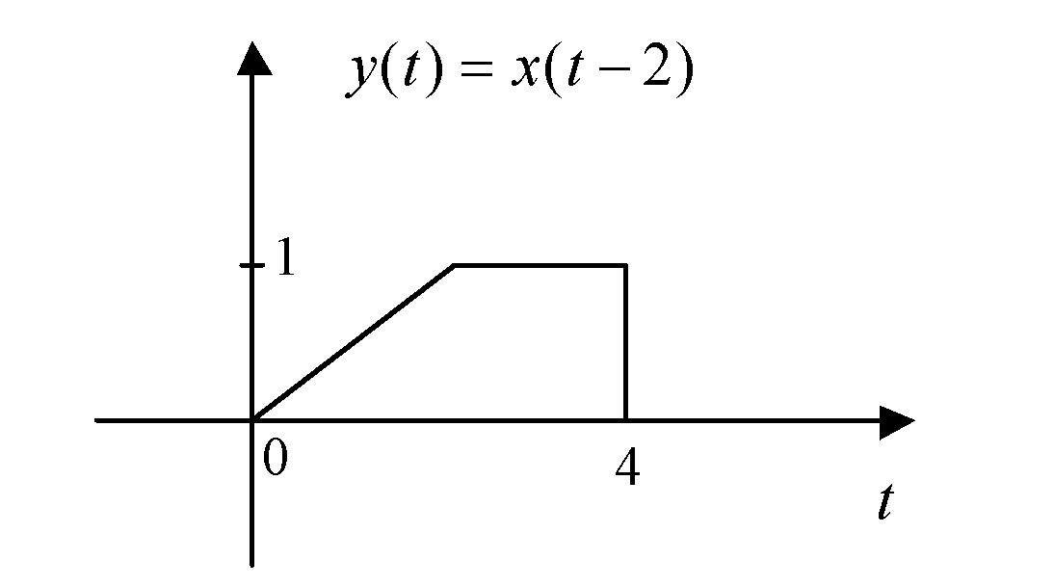
FIGURE 1.11 Graph of time-advanced signal y(t) = x(t + 2).
FIGURE 1.12 Graph of time-delayed signal y(t) = x(t – 2).

Slide 16
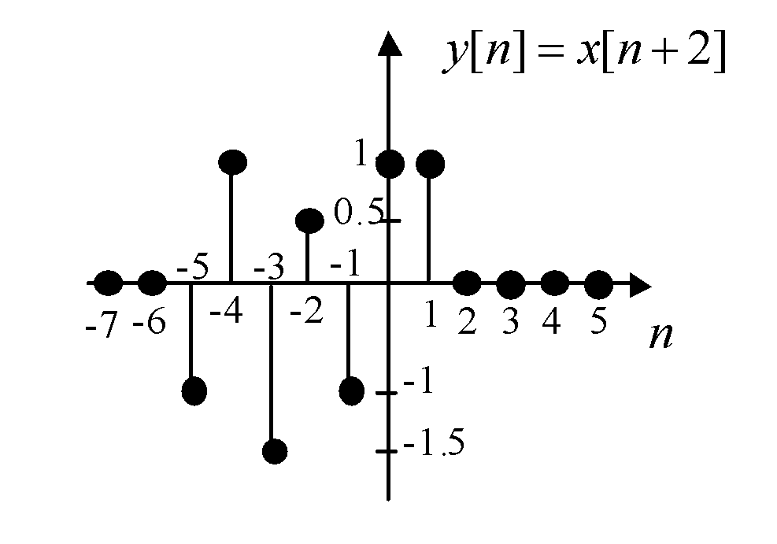
Similarly, a time shift delays or advances a discrete-time signal by an integer discrete-time interval N:
y[n] = x[n +N]
For N positive, the signal is advanced by N time steps, as shown in Figure 1.13. For N negative, the signal is delayed by time steps.
FIGURE 1.13 Graph of time-advanced signal
y[n] = x[n + 2].

Slide 17
PERIODIC SIGNALS
A continuous-time signal x(t) is periodic if there exists a positive real T for which x(t) = x(t +T), ꓯt ϵ R.
A discrete-time signal x[n] is periodic if there exists a positive integer N for which x[n] = x[n + N}, ꓯn ϵ Z.
The smallest such T or N is called the fundamental period of the signal.

Slide 18
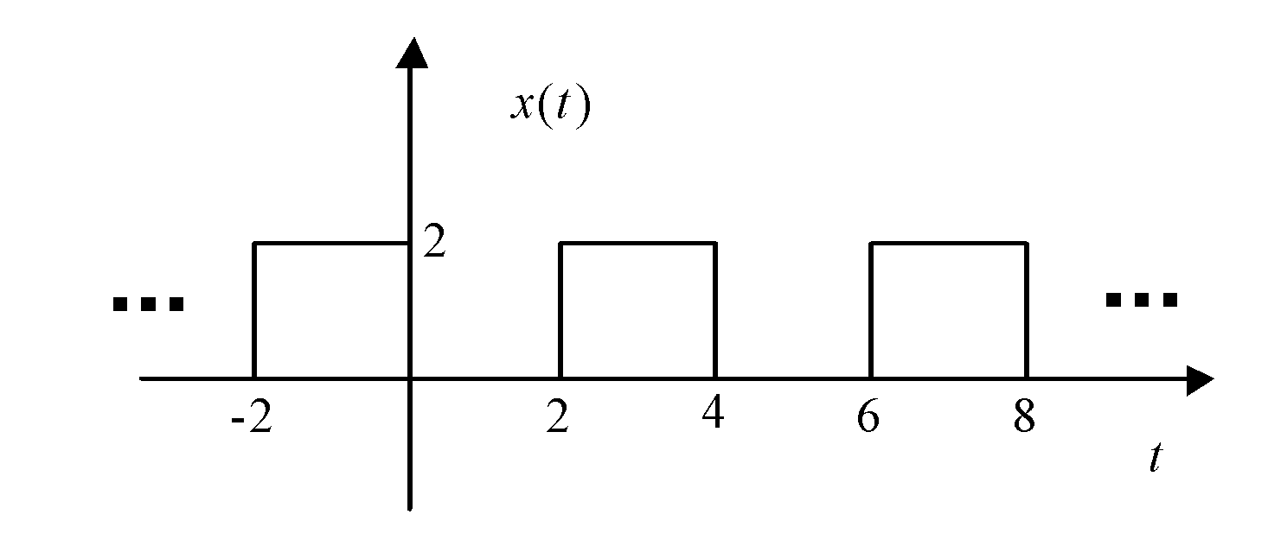
Example 1.6: The square wave signal in Figure 1.14 is periodic. The fundamental period of this square wave is T = 4, but 8, 12, and 16 are also periods of the signal.
FIGURE 1.14 A continuous-time periodic square wave signal.

Slide 19
Example 1.7: The complex exponential signal : x(t) = e^{jω}0^{t} :
x(t + T) = e^{jω}0^{(t+T)} = e^{jω}0^{t} e^{jω}0^{T}
The right-hand side of the Equation above is equal to x(t) = e^{jω}0^{t} for
T = 2πk/ω₀. k = ±1, ±2,……, so these are all periods of the complex exponential. The fundamental period is T = 2π/ω₀.
※ x(t) = e^{jω}0^{t} = cos(ω_{o}t) + j sin(ω_{o}t) → It may become more apparent that the complex exponential signal is periodic.

Slide 20
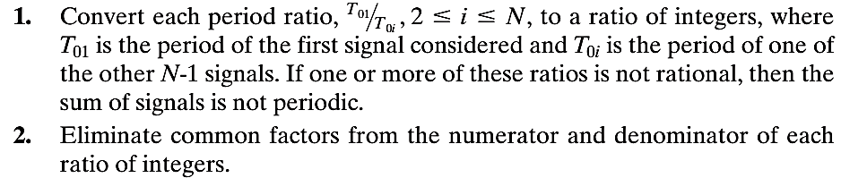
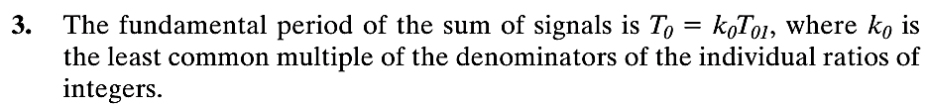
The sum of continuous-time periodic signals is periodic if and only if the ratios of the periods of the individual signals are ratios of integers. If a sum of N periodic signals is periodic, the fundamental period can be found as follows:

Slide 21
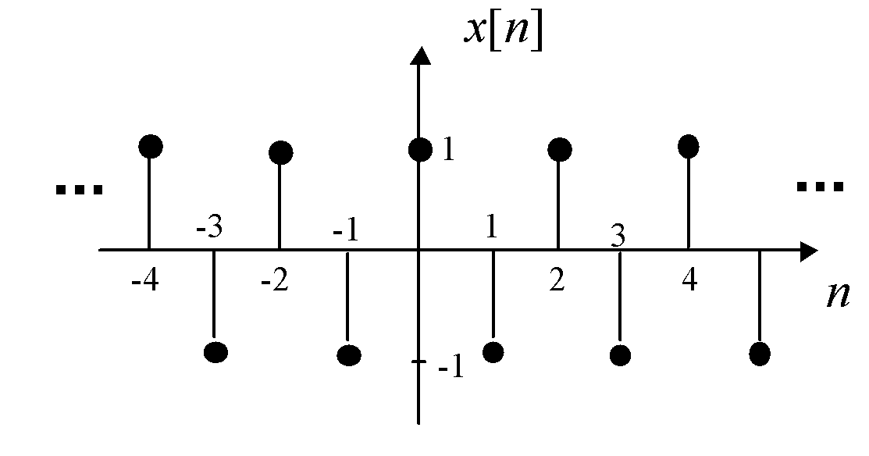
Example 1.8: The discrete-time signal x[n] = (-1)^{n} in Figure 1.15 is periodic with fundamental period N = 2.
FIGURE 1.15 A discrete-time periodic signal.

Slide 22

Signals Periodic in n
We now consider periodic discrete-time signals. By definition, a discrete-time signal x[n] is periodic with period N if
x[n + N] = x[n]
Of course, both n and N are integers.
We first consider the case that the signal x[n] is obtained by sampling a sinusoidal signal x(t) = cos(ω₀t) every T seconds; that is, x[n] = x(nT).
For x[n] to be periodic, from the equation above,
Hence, Nω₀T must be equal to 2πk, where k is an integer.

Slide 23

Therefore,
where T₀ = 2π/ω₀ is the fundamental period of the continuous-time sinusoid. Thus, the ratio of the sample period T to the period of the sinusoid T₀ must be a ratio of integers; that is, T/ T₀ must be rational.
The result of above equation can also be expressed as
NT = kT₀
This relation states that there must be exactly N samples in k periods of the signal cos(ω₀t).

Slide 24
EXPONENTIAL SIGNALS
Exponential signals are extremely important in signals and systems analysis because they are invariant under the action of linear time-invariant systems, which will be discussed in Chapter 2. This means that the output of an LTI system subjected to an exponential input signal will also be an exponential with the same exponent, but in general with a different real or complex amplitude.

Slide 25
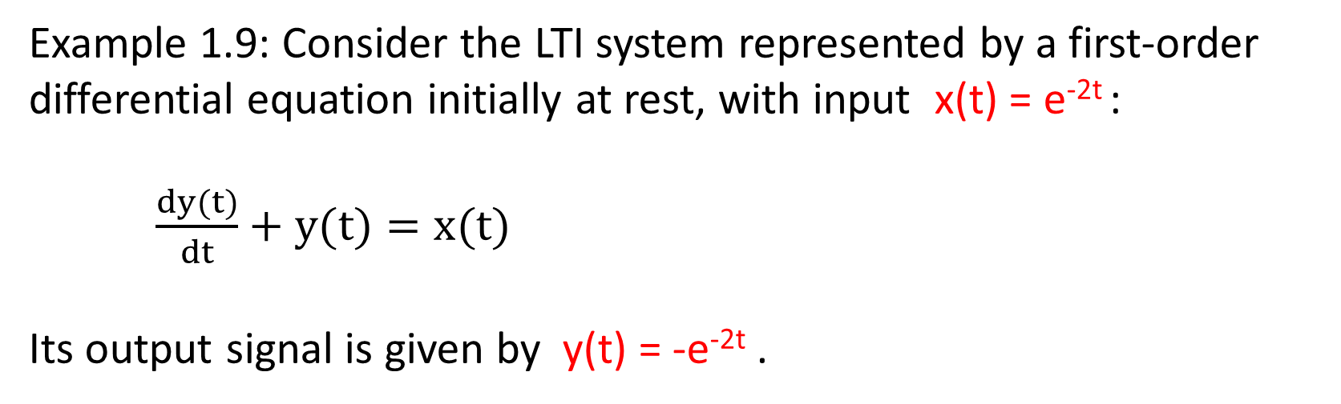
Example 1.9: Consider the LTI system represented by a first-order differential equation initially at rest, with input x(t) = e^{-2t} :
$\frac{dy(t)}{dt}+y(t)=x(t)$
Its output signal is given by y(t) = -e^{-2t} .

Slide 26
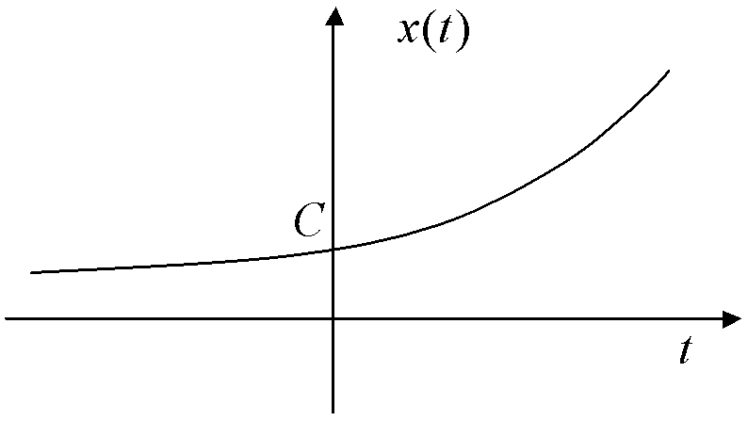
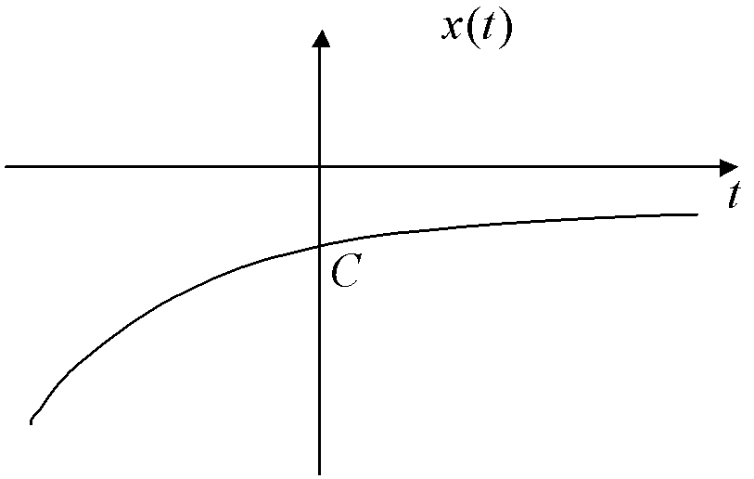
Real Exponential Signals
Continuous Time
We can define a general real exponential signal as follows:
x(t) = Ce^{αt}, 0 ≠ C, α ϵ R.
1. α = 0, x(t) = C.
2. α > 0, C > 0, x(t) is as shown in Figure 1.16.
3. α < 0, C < 0, x(t) is as shown in Figure 1.17.
FIGURE 1.16 Continuous-time exponential signal growing unboundedwith time.
FIGURE 1.17 Continuous-time exponential signal tapering off to zero with time.

Slide 27
Discrete Time
We define a general real discrete-time exponential signal as follows:
x[n] = Cα^{n}, C, α ϵ R.
If C > 0
1. α = 1, x[n] = C.
2. α > 1, x[n] is as shown in Figure 1.18.
3. 0 < α < 1, x [n] = Cα^{n} is as shown in Figure 1.19.
4. α < -1, x [n] = Cα^{n} is as shown in Figure 1.20.
5. α = -1, x[n] is as shown in Figure 1.21.
6. -1 < α < 0, x[n] is as shown in Figure 1.22.

Slide 28
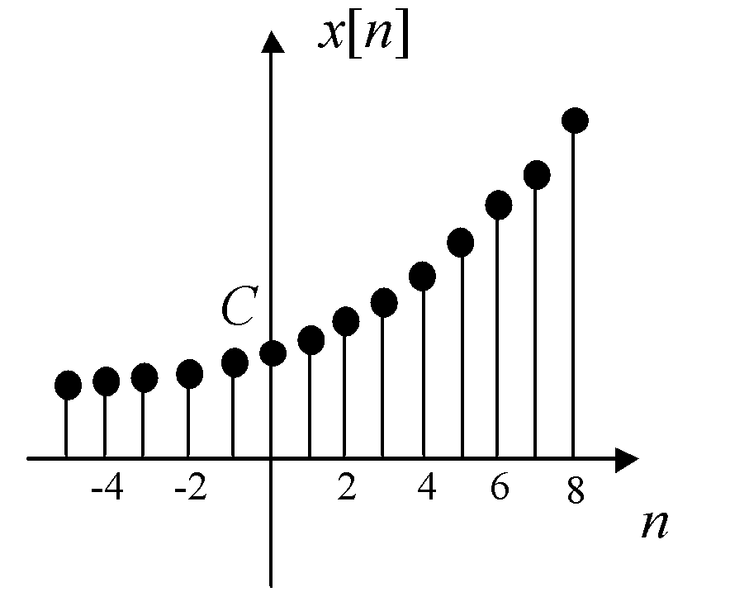
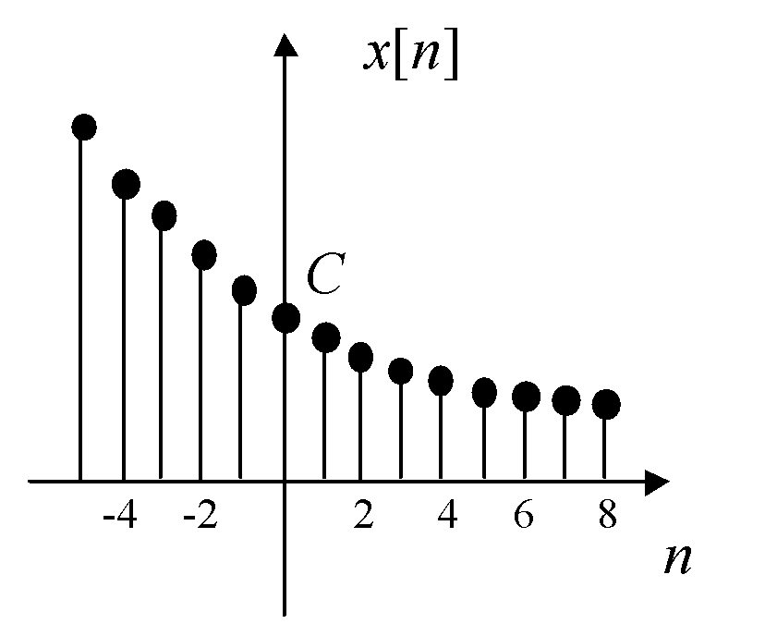
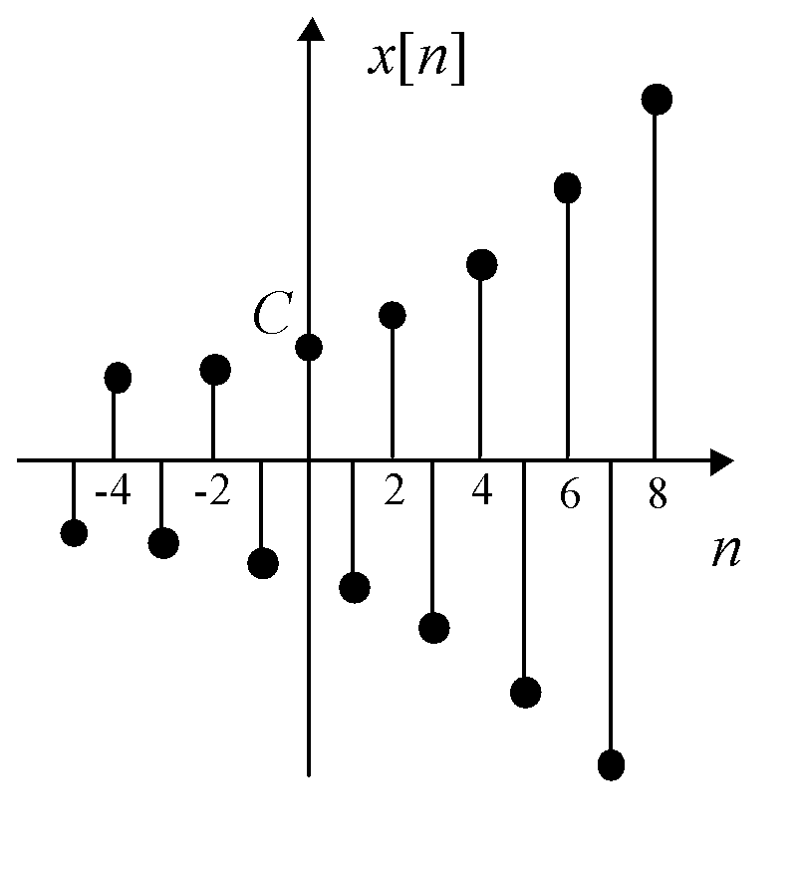
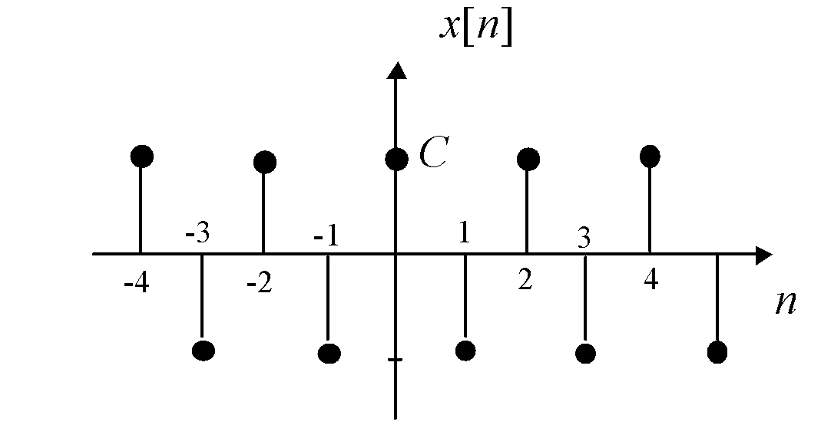
FIGURE 1.18 Discrete-time exponential
signal growing unbounded with time.
FIGURE 1.19 Discrete-time
exponential signal tapering off to
zero with time.
FIGURE 1.20 Discrete-time
exponential signal alternating and
growing unbounded with time.
FIGURE 1.22 Discrete-time exponential signal alternating and tapering off to zero with time.
FIGURE 1.21 Discrete-time exponential signal reduced to an alternating periodic signal.

Slide 29
Complex Exponential Signals
Continuous Time
The continuous-time complex exponential signal can be defined as follows:
x(t) = Ce^{at}, C, a ϵ C,
where C = Ae^{jθ} , A, θ ϵ R, A > 0 is expressed in polar form, and a = α + jω₀,
α, ω₀ ϵ R is expressed in rectangular form.
x(t) = Ae^{jθ} e^{(α + jω}0^{) t} = Ae^{αt} e^{j(ω}0^{t +θ)}

Slide 30
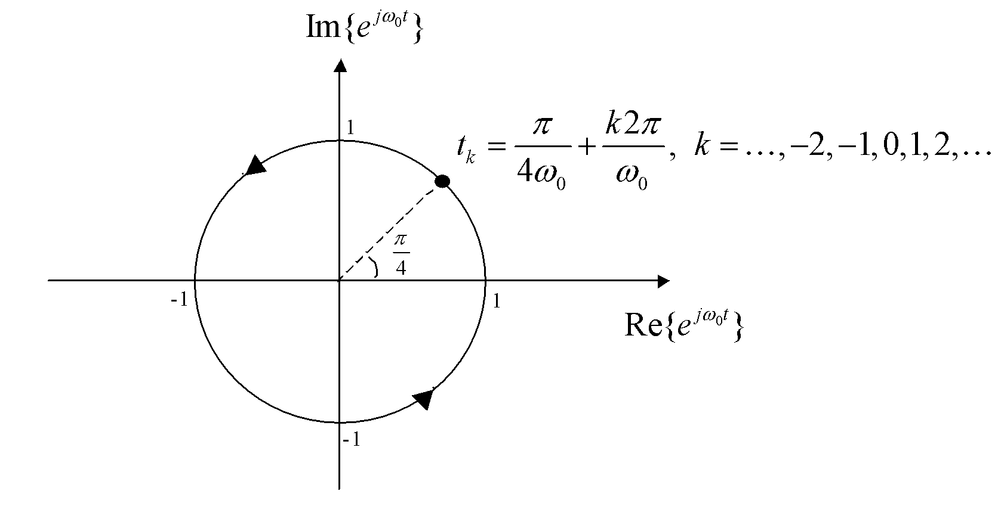
For the case θ = 0, the graph of e^{jω}0^{t} is shown in Figure 1.23.
FIGURE 1.23 Trajectory described by the complex exponential.

Slide 31
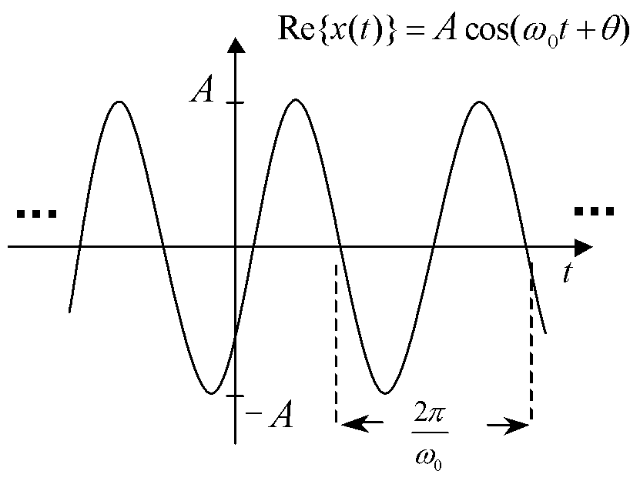
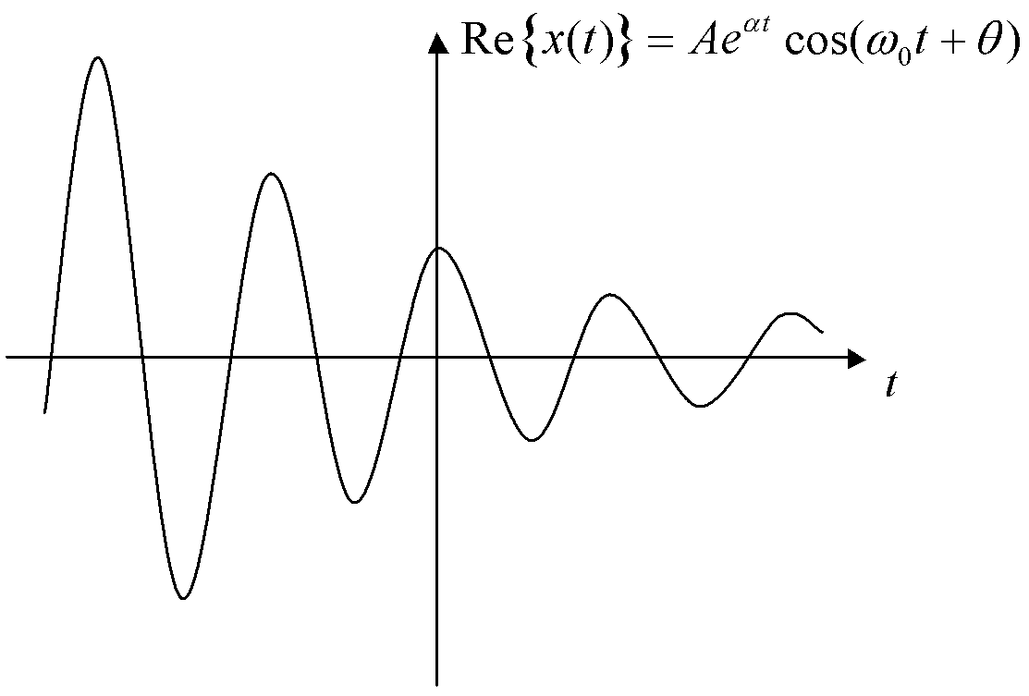
FIGURE 1.24 Real part of periodic complex exponential for α = 0.
FIGURE 1.25 Real part of damped complex exponential for α < 0.
FIGURE 1.26 Real part of growing complex exponential for α > 0

Slide 32
Discrete Time
The discrete-time complex exponential signal can be defined as follows:
x[n] = Ca^{n},
where C, a ϵ C, C = Ae^{jθ} , A, θ ϵ R, A > 0 a = re^{jω}0 , r, ω₀ ϵ R, r > 0
x [n] = Ae^{jθ} r^{n}e^{jω}0^{n} = Ar^{n}e^{j(ω}0^{n +θ)}
and using Euler’s relation, we get the rectangular form of the discrete-time complex exponential:
x [n] =Ar^{n} cos (ω₀n +θ) + j Ar^{n} sin (ω₀n +θ)
Clearly, the magnitude r of a determines whether the envelope of x[n] grows, decreases, or remains constant with time.

Slide 33
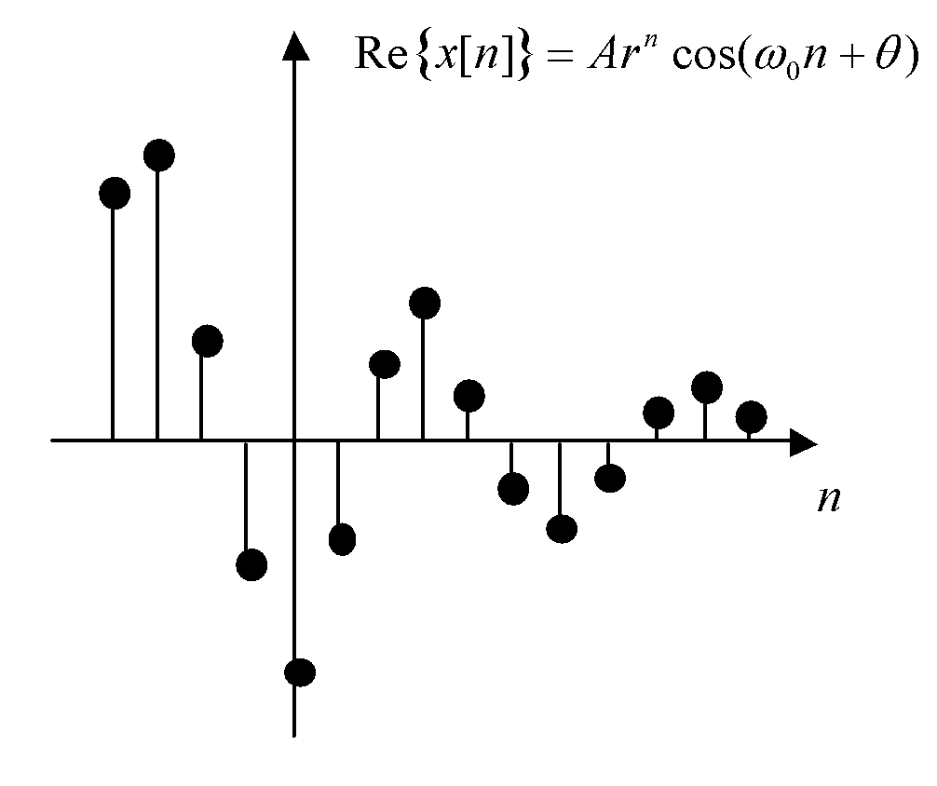
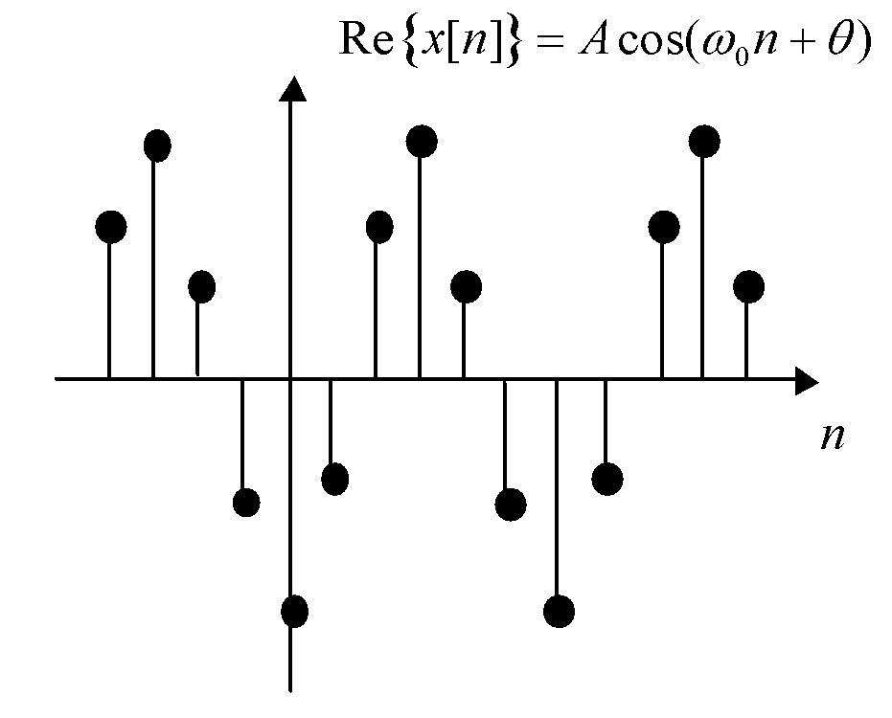
FIGURE 1.27 Real part of discretetime complex exponential for r = 1.
FIGURE 1.28 Real part of discrete-time damped complex exponential for r < 1.
FIGURE 1.29 Real part of growing complex exponential
for r > 1.

Slide 34

PERIODIC COMPLEX EXPONENTIAL AND SINUSOIDAL SIGNALS
Continuous Time
In continuous time, complex exponential and sinusoidal signals of constant amplitude are all periodic.
Periodic Complex Exponentials
Now let us consider harmonically related complex exponential signals:
φ_{K} (t) := e^{jkω}0^{t} , k = ……, -2,-1,0,1,2,………(1.20)
These harmonically related signals have a very important property: they
form an orthogonal set. Two signals are said to be orthogonal over an interval if their inner product, as defined in Equation 1.21, is equal to zero:
(1.21)

Slide 35
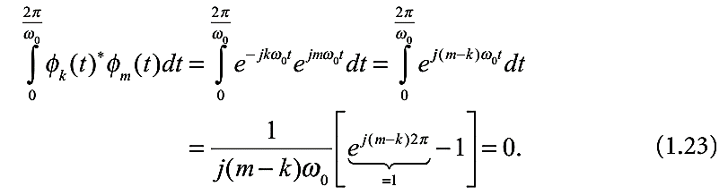
where x*(t) is the complex conjugate of x(t).
We now show that any two distinct complex harmonics φ_{K} (t) = e^{jkω}0^{t} and φ_{m} (t) = e^{jmω}0^{t}, where m ≠ k are indeed orthogonal over their common period T = 2π/ω₀ :

Slide 36
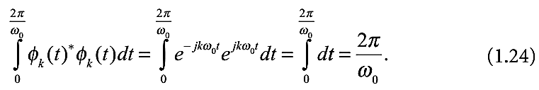
However, the inner product of a complex harmonic with itself evaluates to T = 2π/ω₀ :

Slide 37
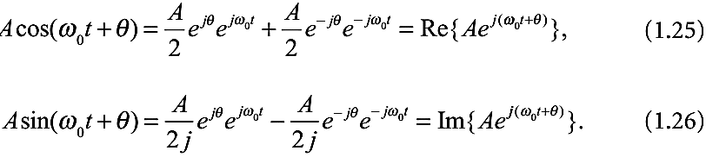
2. Sinusoidal Signals
Continuous-time sinusoidal signals of the type x(t) = Acos(ω₀t + θ) or
x(t) = Asin(ω₀t + θ) are periodic with (fundamental) period T = 2π/ω₀, frequency f₀ = ω₀/2π in Hertz, angular frequency ω₀ in radians per
second, and amplitude |A|.
The following useful identities allow us to see the link between a periodic
complex exponential and the sine and cosine waves of the same frequency and amplitude.

Slide 38

Discrete Time
In discrete time, complex exponential and sinusoidal signals of constant amplitude are not necessarily periodic.
Complex Exponential Signals：The complex exponential signal Ae^{jω}0^{n} is not periodic in general, although it seems like it is for any ω₀.
The discrete-time complex harmonic signals defined by
are periodic of (not necessarily fundamental) period N. They are also orthogonal, with the integral replaced by a sum in the inner product:

Slide 39
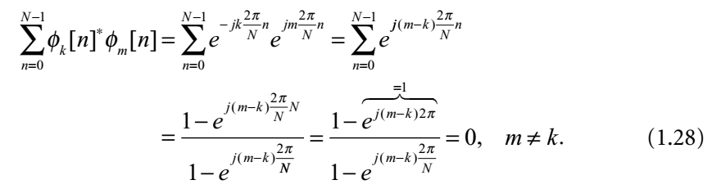
Here there are only N such distinct complex harmonics. For example, for N = 8, we could easily check that φ₀[n] = φ₈[n] = 1.

Slide 40
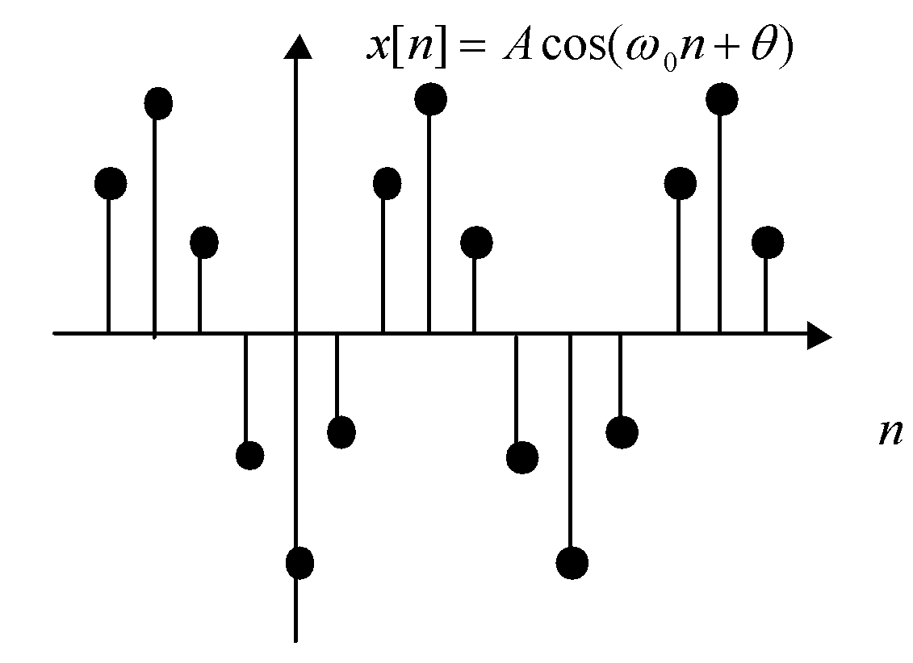
Sinusoidal Signals
Discrete-time sinusoidal signals of the type x[n] = Acos(ω₀n + θ) are not always periodic, although the continuous envelope of the signal Acos(ω₀t + θ) is periodic of period T = 2π/ω₀. A periodic discrete-time sinusoid such as the one in Figure 1.31 is such that the signal values, which are samples of the continuous envelope, always repeat the same pattern over any period of the envelope.
FIGURE 1.31 A periodic discrete-time sinusoidal signal.

Slide 41


Mathematically, we saw that x[n] is periodic if there exists an integer N > 0 such that
x[n] = x[n + N] = Acos(ω₀n + ω₀N + θ) (1.29)
That is, we must have ω₀N = 2πm for some integer m, or equivalently:
that is, ω₀ /2π must be a rational number (the ratio of two integers.) Then, the fundamental period N > 0 can also be expressed as m(2π)/ ω₀,
assuming m and N have no common factor. The fundamental frequency defined by
is expressed in radians.

Slide 42


FINITE-ENERGY AND FINITE-POWER SIGNALS
The instantaneous power dissipated in a resistor of resistance R is
The total energy dissipated during a time interval [t₁,t₂] is

Slide 43

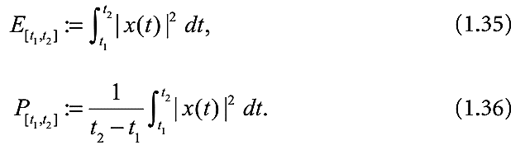
The average power dissipated over that interval is
Analogously, the total energy and average power over of an arbitrary
integrable continuous-time signal x(t) are defined as though the signal were a voltage across a one-ohm resistor:

Slide 44
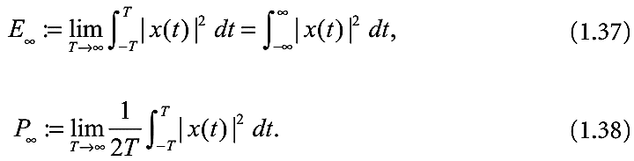
The total energy and total average power of a signal defined over t ϵ R are defined as

Slide 45

The total energy and average power over [n₁,n₂] of an arbitrary discrete-time signal x[n] are defined as

Slide 46
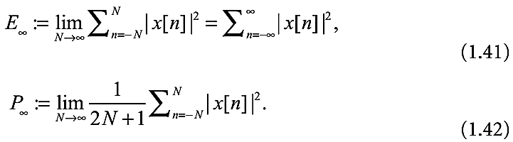
The total energy and total average power of signal x[n] defined over
n ϵ Z are defined as

Slide 47
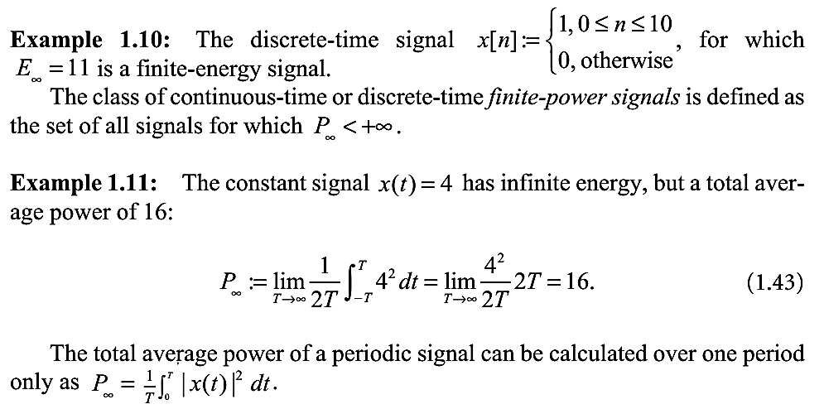

Slide 48
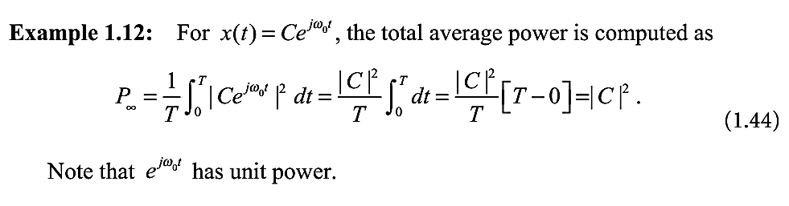

Slide 49
EVEN AND ODD SIGNALS
A continuous-time signal is said to be even if x(t) = x(-t), and a discrete-time signal is even if x[n] = x[-n]. An even signal is therefore symmetric with respect to the vertical axis.
A signal is said to be odd if x(t) = -x(-t), or x[n] = -x[-n]. Odd signals are symmetric with respect to the origin.

Slide 50
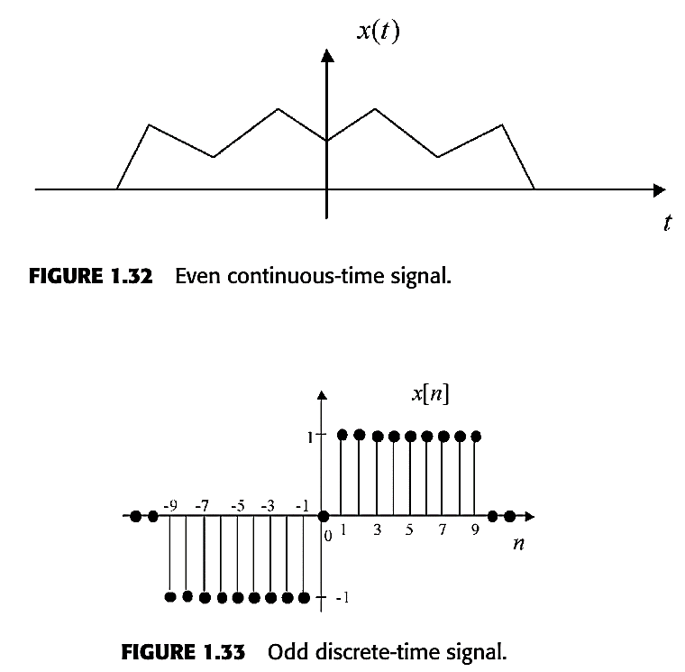
Figure 1.32 shows a continuous-time even signal, whereas Figure 1.33 shows a discrete-time odd signal.

Slide 51
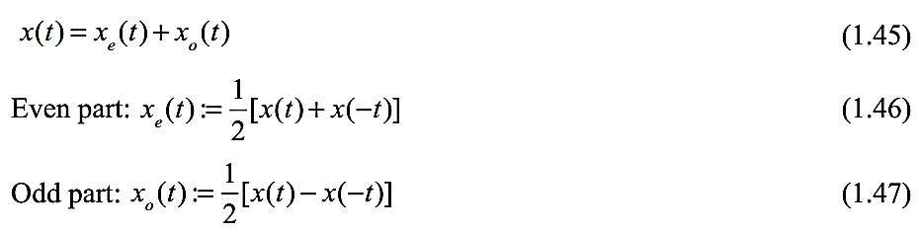
Any signal can be decomposed into its even part and its odd part as follows:
The even part and odd parts of a discrete-time signal are defined in the exact same way.

Slide 52

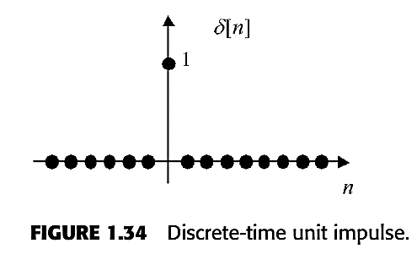
DISCRETE-TIME IMPULSE AND STEP SIGNALS
One of the simplest discrete-time signals is the unit impulse δ[n], also called the Dirac delta function, defined by
Its graph is shown in Figure 1.34.

Slide 53

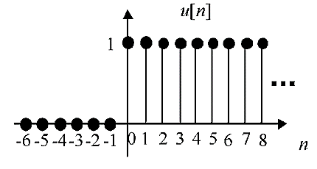
The discrete-time unit step signal u[n] is defined as follows:
The unit step is plotted in Figure 1.35.
FIGURE 1.35
Discrete-time unit
step signal.

Slide 54

The unit step is the running sum of the unit impulse:
The unit impulse is the first-difference of a unit step:
Also, the unit step can be written as an infinite sum of time-delayed unit impulses:

Slide 55

The sampling property
Another way to look at the sampling property

Slide 56
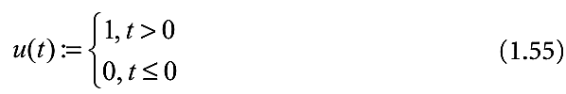
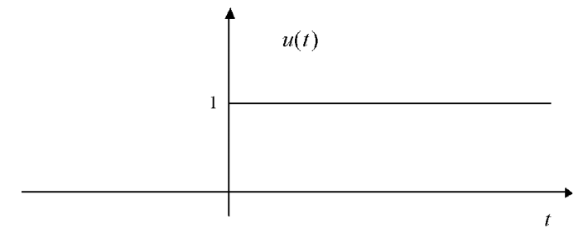
GENERALIZED FUNCTIONS
Continuous-Time Impulse and Step Signals
The continuous-time unit step function u(t), plotted in Figure 1.36, is defined as follows:
FIGURE 1.36
Continuous-time unit step signal

Slide 57
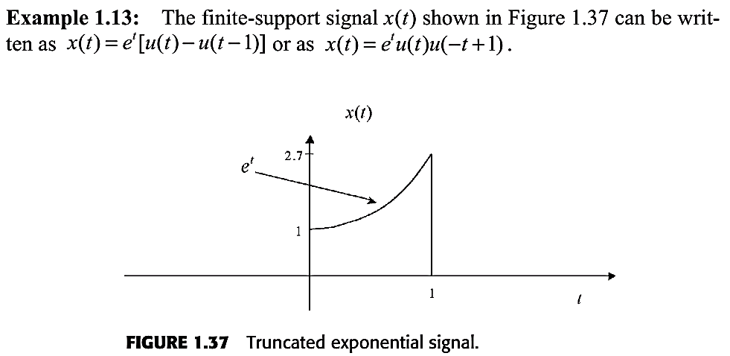

Slide 58

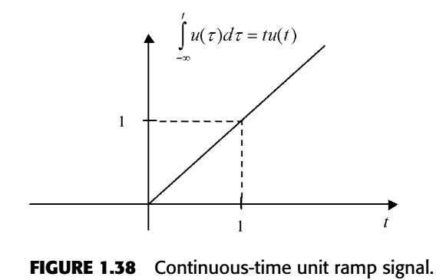
The running integral of u(t) is the unit ramp signal tu(t) starting at t = 0, as shown in Figure 1.38:

Slide 59
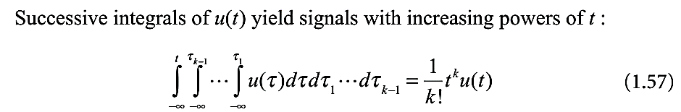
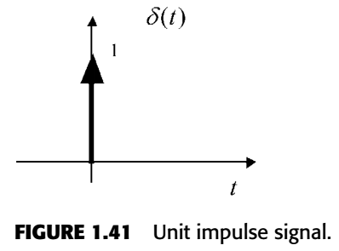

The unit impulse δ(t) is represented by an arrow “pointing to infinity” at t = 0 with its length equal to the area of the impulse, as shown in Figure 1.41.
The unit step is the running integral of the unit impulse:
(1.62)

Slide 60

Some Properties of the Impulse Signal
Sampling Property

Slide 61

Time Scaling

Slide 62


Time Shift
The convolution of signals x(t) and y(t) is defined as
The convolution of signal x(t) with the time-delayed impulse δ(t-T) delays the signal by T:

Slide 63


Unit Doublet and Higher Order “Derivatives” of the Unit Impulse
For higher order derivatives of δ(T), we have

Slide 64

A “double impulse” at t = 0, as shown in Figure 1.44.

Slide 65
SYSTEM MODELS AND BASIC PROPERTIES
In this book, a system is simply defined as a mathematical relationship, that is, a function, between an input signal x(t) or x[n] and an output signal y(t) or y[n].
Input-Output System Models
The mathematical relationship of a system H between its input signal and its output signal can be formally written as y = Hx (the time argument is dropped here, as this representation is used both for continuous-time and discrete-time systems).
System H could represent a very complicated nonlinear differential equation linking y(t) to x(t).

Slide 66

A system is often conveniently represented by a block diagram, as shown in Figure 1.45 and Figure 1.46.

Slide 67

System Block Diagrams
Systems may be interconnections of other systems. For example, the discrete-time system y[n] = Gx[n] shown as a block diagram in Figure 1.47 can be described by the following system equations:

Slide 68


Slide 69

Cascade Interconnection
The cascade interconnection shown in Figure 1.48 is a successive application of two (or more) systems on an input signal:

Slide 70

Parallel Interconnection
The parallel interconnection shown in Figure 1.49 is an application of two (or more) systems to the same input signal, and the output is taken as the sum of the outputs of the individual systems.

Slide 71

Feedback Interconnection
The feedback interconnection of two systems as shown in Figure 1.50 is a feedback of the output of system G1 to its input, through system G2.

Slide 72

Basic System Properties
All of the following system properties apply equally to continuous-time and discrete-time systems.

Slide 73


Slide 74


Memory
A system is memoryless if its output y at time t or n depends only on the input at that same time.
Examples of memoryless systems: y[n] = x[n]² ；
Resistor: v(t) = Ri(t)
Conversely, a system has memory if its output at time t or n depends on input values at some other times.
Examples of systems with memory: y[n] = x[n+1] + x[n] + x[n-1]

Slide 75

Causality
A system is causal if its output at time t or n depends only on past or current values of the input.
Examples of causal systems:

Slide 76


Slide 77


Slide 78
Invertibility
Recall that a system was defined as a function mapping a set of input signals (domain) into a set of output signals (co-domain). The range of the system is the subset of output signals in the co-domain that are actually possible to get.
It turns out that one can always restrict the co-domain of the system to be equal to its range, thereby making the system onto (surjective). Assuming this is the case, a system S is invertible if the input signal can always be uniquely recovered from the output signal.
Functions are invertible if and only if they are both one-to-one and onto.

Slide 79

The inverse system, formally written as S^{–1} (this is not the arithmetic inverse), is such that the cascade interconnection in Figure 1.54 is equivalent to the identity system, which leaves the input unchanged.

Slide 80

The End of Chap. 01

